Slide 1

Artificial Intelligence for Network Traffic Management
CSA0708 - COMPUTER NETWORKS
Guided by
Dr. S. Saraswathi
Dhanush S
192524317

Slide 2
INTRODUCTION
Artificial Intelligence (AI) helps computer networks automatically monitor, analyze, and manage data traffic efficiently.
AI predicts network congestion and selects the best routing path to improve communication speed and reliability.
It reduces network delays, packet loss, and bandwidth wastage by making intelligent real-time decisions.
AI detects abnormal traffic patterns, helping to identify cyber threats and prevent network failures.

Slide 3
OBJECTIVES
To improve network performance by optimizing traffic flow using Artificial Intelligence.
To reduce network congestion through intelligent traffic prediction and routing.
To minimize delays and packet loss for faster and more reliable communication.
To detect network anomalies and cyber threats using AI-based monitoring techniques.
To enhance bandwidth utilization and ensure efficient use of network resources.

Slide 4
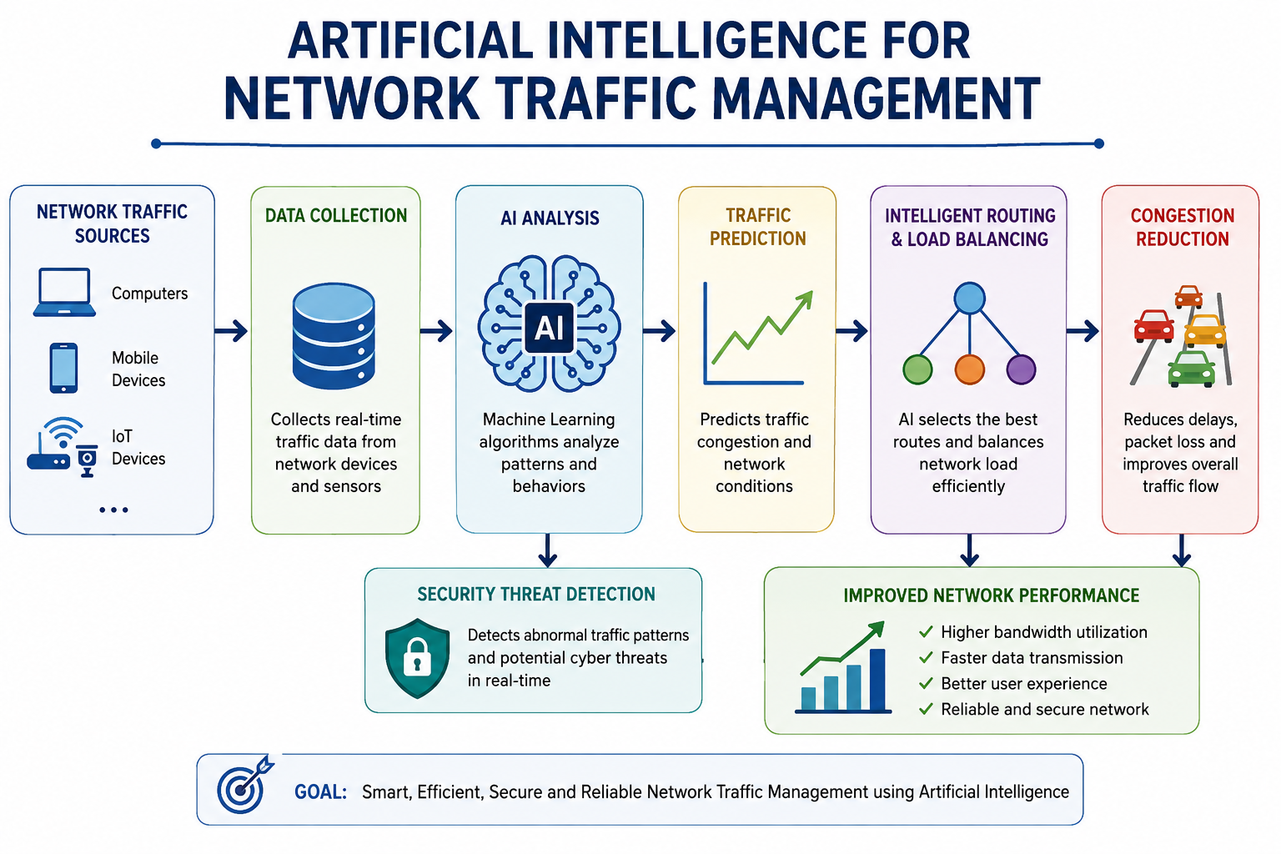

Slide 5
APPLICATIONS
5G Networks – Optimizes traffic for faster and stable communication.
Cloud Computing – Balances network load across cloud servers.
Data Centers – Improves resource allocation and reduces congestion.
IoT Networks – Manages traffic from connected smart devices efficiently.
Cybersecurity – Detects unusual traffic and prevents network attacks.

Slide 6
CONCLUSION
Artificial Intelligence makes network traffic management faster, smarter, and more efficient.
It reduces congestion, delays, and packet loss while improving network performance.
AI helps detect network problems and cyber threats in real time.
It optimizes bandwidth usage and ensures reliable communication.

